Slide 1
SQL Views, Transactions, Integrity Constraints Prof Dr Melike Sah Direkoglu

Slide 2
Outline
Views
Transactions
Integrity Constraints
SQL Data Types and Schemas
Notes:
1

Slide 3
Views
In some cases, it is not desirable for all users to see the entire logical model (that is, all the actual relations stored in the database.)
Consider a person who needs to know an instructors name and department, but not the salary. This person should see a relation described, in SQL, by select ID, name, dept_name from instructor
A view provides a mechanism to hide certain data from the view of certain users.
Any relation that is not of the conceptual model but is made visible to a user as a “virtual relation” is called a view.

Slide 4
View Definition
A view is defined using the create view statement which has the form
create view v as < query expression >
where <query expression> is any legal SQL expression. The view name is represented by v.
Once a view is defined, the view name can be used to refer to the virtual relation that the view generates.
View definition is not the same as creating a new relation by evaluating the query expression
Rather, a view definition causes the saving of an expression; the expression is substituted into queries using the view.

Slide 5
Create View Examples
Create a view of instructors without their salary
Note that instructor relation contains; ID, name, dept_name, salary
create view faculty as select ID, name, dept_name from instructor

Slide 6
Create View Examples
Create a view for all instructors in the Biology department without the salary information
create view biologyfaculty as select ID, name, dept_name from instructor where dept_name = 'Biology'

Slide 7
Create View Examples
Create a view of department and total salary for each department (i.e.
Comp_sci 502000
Biology 256001
…. ….
Note that instructor relation contains; ID, name, dept_name, salary
create view departments_total_salary(dept_name, total_salary) as select dept_name, sum (salary) from instructor group by dept_name;

Slide 8
Views Defined Using Other Views
One view may be used in the expression defining another view
A view relation v₁ is said to depend directly on a view relation v₂ if v₂ is used in the expression defining v₁
A view relation v₁ is said to depend on view relation v₂ if either v₁ depends directly to v₂ or there is a path of dependencies from v₁ to v₂
A view relation v is said to be recursive if it depends on itself.

Slide 9
Views Defined Using Other Views
Create a view of physics courses in fall 2017
create view physics_fall_2017 as select course.course_id, sec_id, building, room_number from course, section where course.course_id = section.course_id and course.dept_name = 'Physics' and section.semester = 'Fall' and section.year = '2017’;
Create a view of physics courses in fall 2017 and in the Watson building; using the view we created above
create view physics_fall_2017_watson as select course_id, room_number from physics_fall_2017 where building= 'Watson';

Slide 10
View Expansion
Expand the view :
create view physics_fall_2017_watson as select course_id, room_number from physics_fall_2017 where building= 'Watson'
To:
create view physics_fall_2017_watson as
select course_id, room_number
from (select course.course_id, building, room_number
from course, section
where course.course_id = section.course_id
and course.dept_name = 'Physics'
and section.semester = 'Fall'
and section.year = '2017')
where building= 'Watson';

Slide 11
View Expansion (Cont.)
A way to define the meaning of views defined in terms of other views.
Let view v₁ be defined by an expression e₁ that may itself contain uses of view relations.
View expansion of an expression repeats the following replacement step:
repeat Find any view relation v_{i} in e₁ Replace the view relation v_{i} by the expression defining v_{i} until no more view relations are present in e₁
As long as the view definitions are not recursive, this loop will terminate

Slide 12
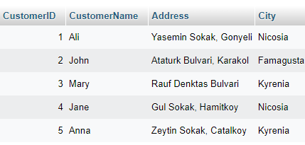
View Example in MySQL – Customer Table
Create a view for the Customer Table where only customers from Kyrenia can be visualized!

Slide 13
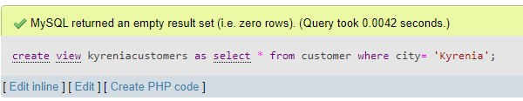
KyreniaCustomers View
create view kyreniacustomers as select * from customer where city= 'Kyrenia’
No results will be displayed! To view the created view you need to write a SQL query as follows →

Slide 14
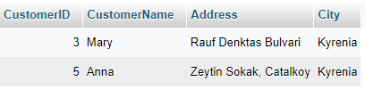
Query the Created KyreniaCustomer View
select * from kyreniacustomers;

Slide 15
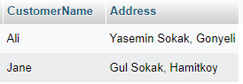
View Creation for NicosiaCustomers
create view nicosiacustomers as select customername, address from customer where city= ‘Nicosia’
Then to view
Select * from nicosiacustomers

Slide 16
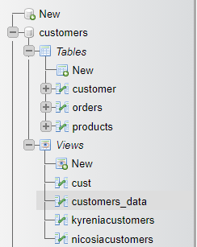
Accessing the Views in MySQL
Created views of the database are shown as follows:

Slide 17
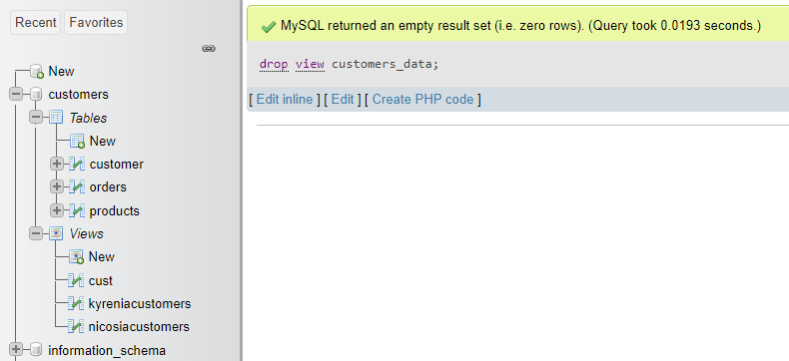
How to Delete a View?
To delete a views use the definition:
Drop view view_name;
drop view customers_data;

Slide 18
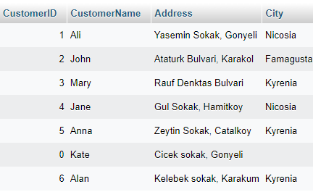
Edit the Customer Table
INSERT INTO `customer`(`CustomerID`, `CustomerName`, `Address`, `City`) VALUES ('6','Alan','Kelebek sokak, Karakum','Kyrenia')

Slide 19
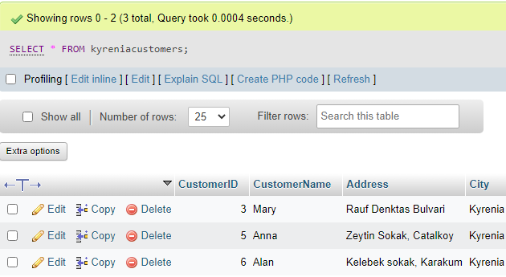
What Happens to the View?
Query the Created KyreniaCustomer View Again?
select * from kyreniacustomers;
What is the result?

Slide 20
Materialized Views
Certain database systems allow view relations to be physically stored.
Physical copy created when the view is defined.
Such views are called Materialized view:
Materialized views are not virtual!

Slide 21
Create Materalized View
CREATE TABLE info ( id INT PRIMARY KEY AUTO_INCREMENT, seller_id INT, _date date, amount INT );
INSERT INTO info(seller_id, _date, amount) VALUES (101, "2021-01-05", 200), (111, "2021-01-05", 600), (121, "2021-02-05", 1000);
CREATE TABLE materialized_view ( SELECT seller_id, _date, SUM(amount * 12 * 8) as total_amount
FROM info
WHERE _date < CURRENT_DATE
ORDER BY seller_id );

Slide 22
Materialized View
If relations used in the query are updated, the materialized view result becomes out of date
Need to maintain the view, by updating the view whenever the underlying relations are updated.

Slide 23
Transactions
A transaction is a “unit” of work that consists of a sequence of
query and/or
update statements and
The SQL standard specifies that a transaction begins implicitly when an SQL statement is executed.
The transaction must end with one of the following statements:
Commit work. The updates performed by the transaction become permanent in the database.
Rollback work. All the updates performed by the SQL statements in the transaction are undone.
Atomic transaction
either fully executed or rolled back as if it never occurred
Isolation from concurrent transactions

Slide 24
Integrity Constraints
Integrity constraints guard against accidental damage to the database, by ensuring that authorized changes to the database do not result in a loss of data consistency.
A checking account must have a balance greater than $10,000.00
A salary of a bank employee must be at least $4.00 an hour
A customer must have a (non-null) phone number

Slide 25
Constraints on a Single Relation
not null
primary key
unique
check (P), where P is a predicate

Slide 26
Not Null Constraints
not null
Declare name and budget to be not null
name varchar(20) not null budget numeric(12,2) not null

Slide 27
Unique Constraints
unique ( A₁, A₂, …, A_{m})
The unique specification states that the attributes A₁, A₂, …, A_{m} form a candidate key.
Candidate keys are permitted to be null (in contrast to primary keys).

Slide 28
The check clause
The check (P) clause specifies a predicate P that must be satisfied by every tuple in a relation.
Example: ensure that semester is one of fall, winter, spring or summer
create table section
(course_id varchar (8),
sec_id varchar (8),
semester varchar (6),
year numeric (4,0),
building varchar (15),
room_number varchar (7),
time slot id varchar (4),
primary key (course_id, sec_id, semester, year),
check (semester in ('Fall', 'Winter', 'Spring', 'Summer')))

Slide 29
Referential Integrity
Referential Integrity ensures that a value that appears in one relation for a given set of attributes also appears for a certain set of attributes in another relation (for foreign key alignment).
Example: If “Biology” is a department name appearing in one of the tuples in the instructor relation, then there exists a tuple in the department relation for “Biology”.
Let A be a set of attributes. Let R and S be two relations that contain attributes A and where A is the primary key of S. A is said to be a foreign key of R if for any values of A appearing in R these values also appear in S.

Slide 30
Referential Integrity (Cont.)
Foreign keys can be specified as part of the SQL create table statement
foreign key (dept_name) references department
(by default primary of the department table)
By default, a foreign key reference the primary-key attributes of the referenced table.
SQL allows a list of attributes of the referenced relation to be specified explicitly.
foreign key (dept_name) references department (dept_name)
(user specified attribute)

Slide 31
Cascading Actions in Referential Integrity
When a referential-integrity constraint is violated, the normal procedure is to reject the action that caused the violation.
An alternative, in case of delete or update is to cascade
Cascade is used to simultaneously delete or update an entry from both tables.
create table course ( (… dept_name varchar(20), foreign key (dept_name) references department on delete cascade on update cascade, . . .)
Instead of cascade we can use :
On delete set null,
On delete set default

Slide 32
Integrity Constraint Violation During Transactions
Consider:
create table person ( ID char(10), name char(40), mother char(10), father char(10), primary key ID, foreign key father references person, foreign key mother references person)
How to insert a tuple without causing constraint violation?
Insert father and mother of a person before inserting person
OR, set father and mother to null initially, update after inserting all persons (not possible if father and mother attributes declared to be not null)
OR defer constraint checking

Slide 33
Complex Check Conditions
The predicate in the check clause can be an arbitrary predicate that can include a subquery.
check (time_slot_id in (select time_slot_id from time_slot))
The check condition states that the time_slot_id in each tuple in the section relation is actually the identifier of a time slot in the time_slot relation.
The condition has to be checked not only when a tuple is inserted or modified in section , but also when the relation time_slot changes

Slide 34
Built-in Data Types in SQL
Int,
Char
Varchar
….
date: Dates, containing a (4 digit) year, month and date
Example: date '2005-7-27'
time: Time of day, in hours, minutes and seconds.
Example: time '09:00:30' time '09:00:30.75'
timestamp: date plus time of day
Example: timestamp '2005-7-27 09:00:30.75'
interval: period of time
Example: interval '1' day
Subtracting a date/time/timestamp value from another gives an interval value
Interval values can be added to date/time/timestamp values

Slide 35
Large Object Types
Large objects (photos, videos, CAD files, etc.) are stored as a large object:
blob: binary large object -- object is a large collection of uninterpreted binary data (whose interpretation is left to an application outside of the database system). For example images.
clob: character large object -- object is a large collection of character data
When a query returns a large object, a pointer is returned rather than the large object itself.
BLOB can be represented with the regular VARBINARY data types, but with a special length value called MAX:

Slide 36
Large Object Types – Creating Columns with Blob
BLOB can be represented with the regular VARBINARY data types, but with a special length value called MAX (up to 2 GB):
CREATE TABLE Image (
ID INTEGER PRIMARY KEY,
Subject VARCHAR(256) NOT NULL,
Body VARBINARY(MAX));
A query returns a pointer to the image rather than the large object itself.

Slide 37
Large Object Types – Creating Columns with Clob
CLOB can be represented with the regular Long Byte data types
CREATE TABLE clob_table
(
id_num NUMBER,
clob_text LONG BYTE);

Slide 38
User-Defined Types
create type construct in SQL creates user-defined type
create type Dollars as numeric (12,2) final
Example:
create table department (dept_name varchar (20), building varchar (15), budget Dollars);

